Slide 1

First Rotation in Sylvain Baillet’s Lab
Jin Kweon
Notes:
Ok! so, I am doing my first rotation with Sylvain in MNI: Montreal neurological institute.

Slide 2
Describe the lab I am in

Slide 3
Professor Sylvain Baillet
Journal club meeting -> Tue
Group meeting -> Thurs
New QLS supervisor
Do both wet and dry lab
Neuroinformatics, Neuroimaging, Machine learning
Websites:
https://www.mcgill.ca/bic/research/neurospeed-neural-dynamics-brain-systems-baillet
https://mcgill.ca/bbme/sylvain-baillet
Side note: I work closely with Postdoc. Philippe Albouy and MEG system manager at MNI, Marc Lalancette
Notes:
So, we have weekly journal and group meeting.
And, he was invited into QLS this semester.
His lab covers both dry and wet lab – so, I think it is a great opportunity for ppl who are interested in experiencing both of them in the short period of rotation.
He mostly does neuroinformatics, neuroimaging, and machine learning.

Slide 4
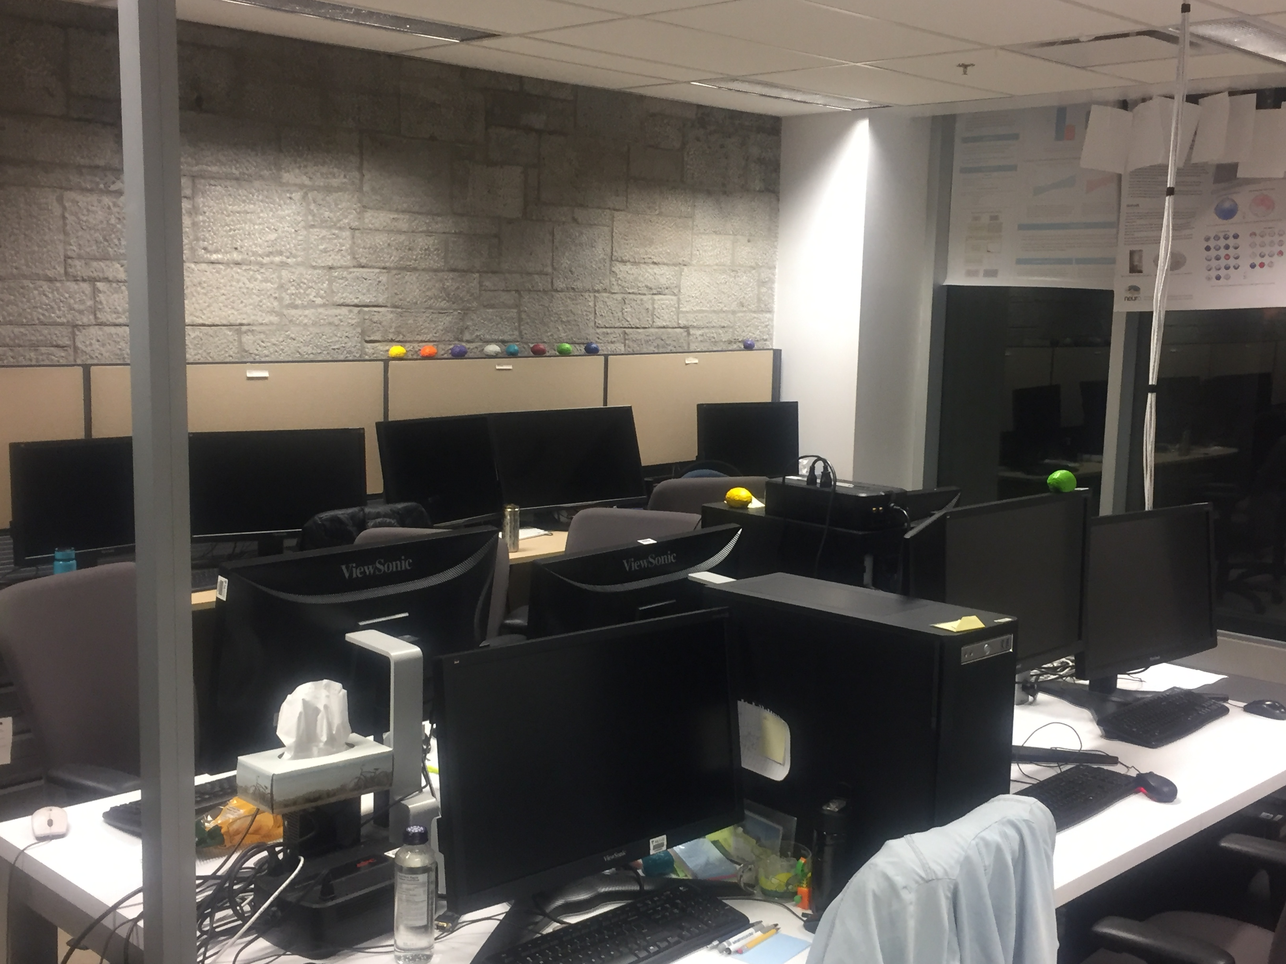
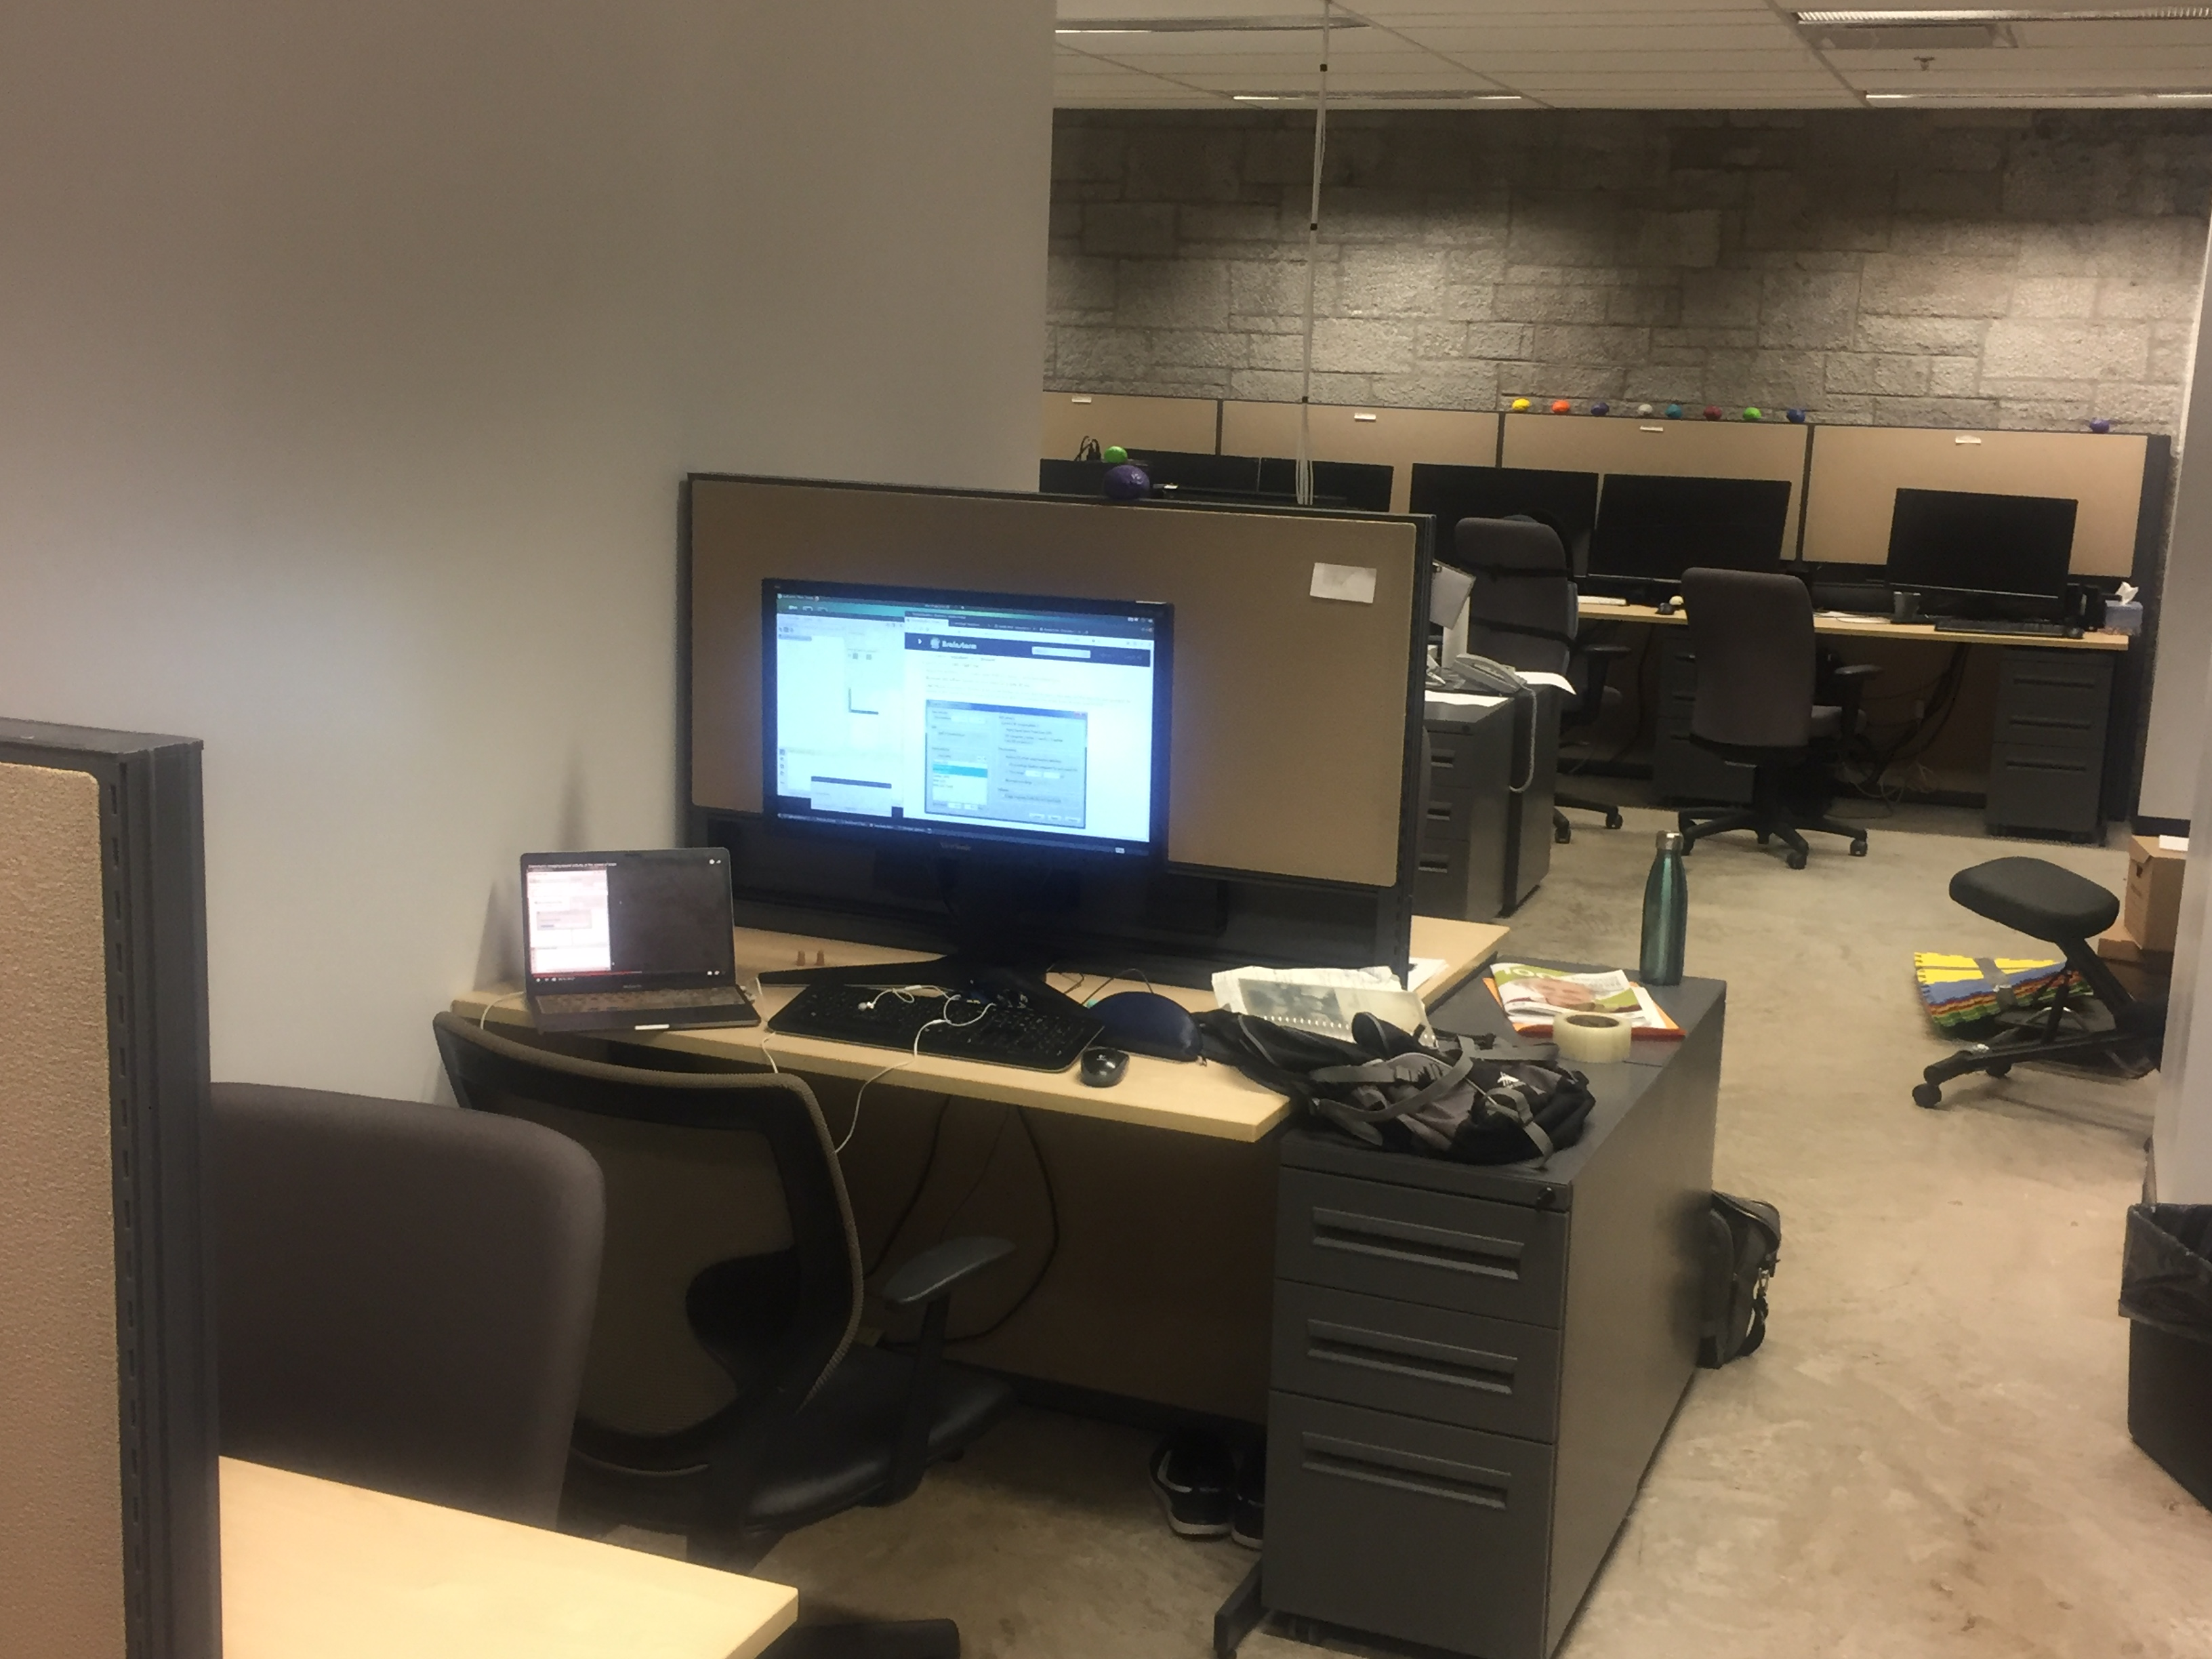
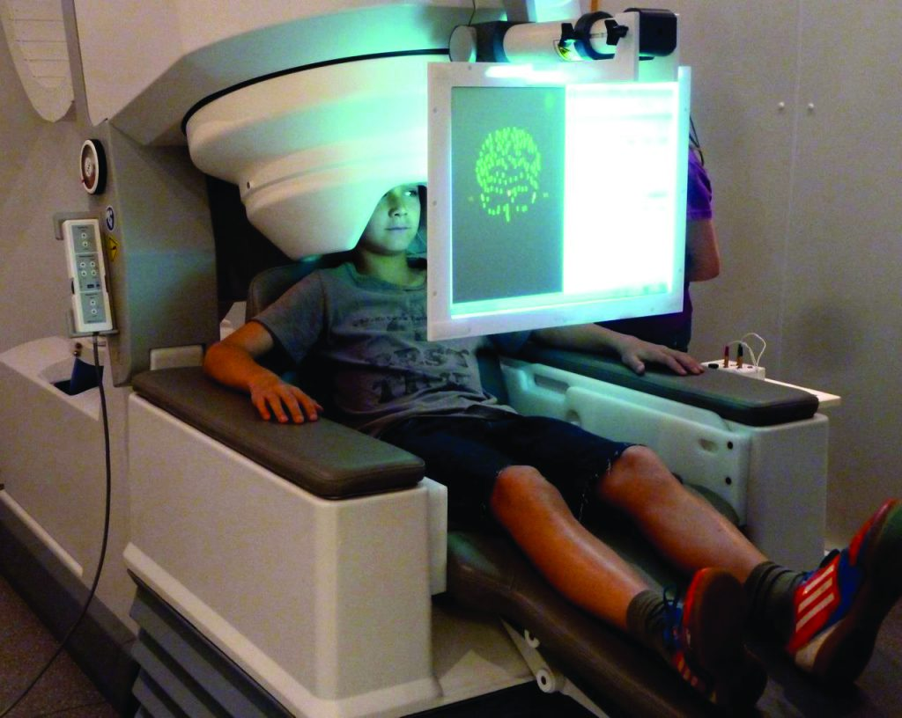
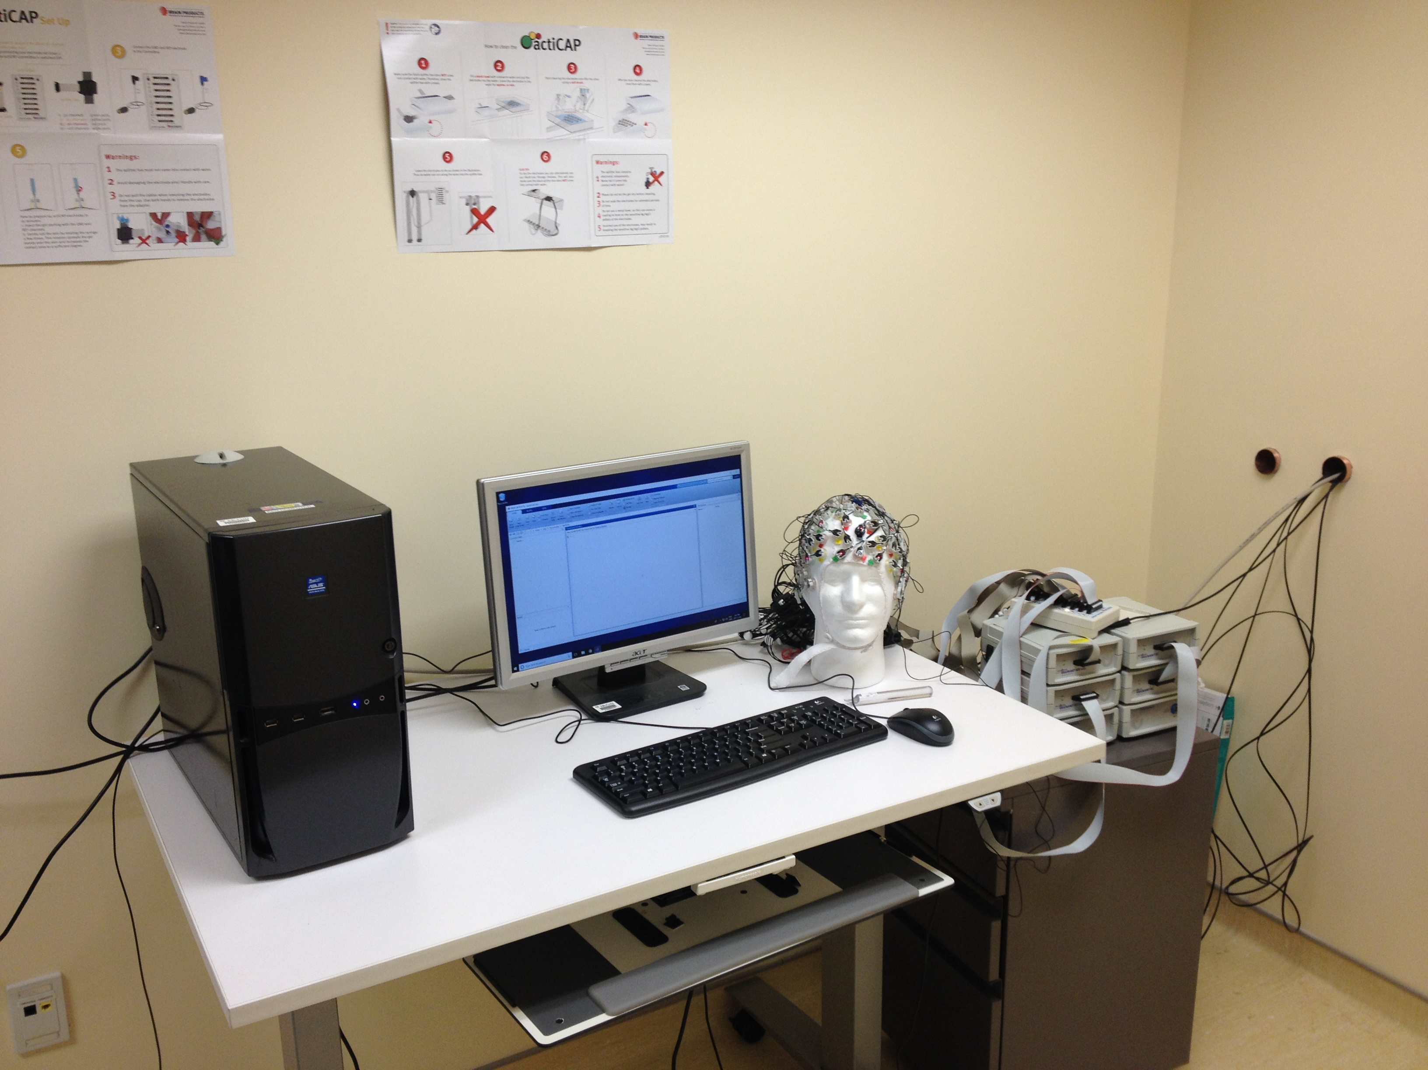
Lab pictures
L3
MEG room
TMS/EEG room
Notes:
I spent most of my times in the workstation on third floor of MNI or TMS room.

Slide 5
What I am working on

Slide 6
Analysis on longitudinal study of the “short-term” effects of brain stimulation with steady state visual stimulation on working memory performances in healthy volunteers
New experiment on “long term” effects of brain stimulation with Transcranial Magnetic Stimulation (TMS) on working memory performances in healthy volunteers
Developing automatic work-flow pipeline for data analysis
Notes:
So, these are the three main things I have worked on.

Slide 7
Why using both MEG and EEG?
 | Pros | Cons
EEG | 1. High temporal resolution and safe 2. Useful in diagnosing degenerative disease of the nervous system | 1. Records only a small sample of electrical activity from the surface of the brain. (poor spatial resolution) 2. Many of the more complex functions of the brain, such as emotions and thought cannot be related closely to EEG. 3. No use in diagnosing psychiatric illness. 4. Not good at accurate spatial localization of neural activities (MEG covers it!!!) -> localization and amplitude bias
MEG | 1. High temporal resolution – but still have spatial resolution 2. Noninvasive 3. It can also show absolute neuronal activity (which fMRI cannot do…) 4. The subject can move during the test (but, monitoring of head movements during data collecting and head positions between the participants are important for data quality and comparison) 5. Reference free (not relative to a common measure) 6. Getting better as there are more available softwares that can deal with large volume of data | 1. Sophistication and maintenance impose substantial costs 2. Helium-based cryogenics are constantly threatened by shortage in natural resources 3. MEG signals are extremely small, so need to eliminate signals from the environment 4. Need multilayered shielded room to host MEG to protect from environmental noise 5. Signals are complicated
Notes:
Before we go into details of what I did, I want to briefly go through the pro and cons for MEG and EEG – the technologies we used the most in the lab.
The most important things I have to keep in mind is that EEG has good temporal resolution, but bad spatial resolution, and MEG covers that!
And, for MEG, although we usually say there is a trade-off between spatial and temporal resolution in general, it has decent temporal and spatial resolution, but, it costs a lot to maintain the big machines and signals are more complicated.
--------------------------------------------------------------------------------------------------------------------------------------------------------------------------------------------------------------------------------------------------------------------
There are other techniques: Functional MRI and PET have resolutions of several seconds, but, our signal of interest is in the range of the milli-sec.
<Ref>
https://www.youtube.com/watch?v=1ovv6lmPHSI
https://www.ucalgary.ca/i3t/files/i3t/baillet_2017.pdf

Slide 8
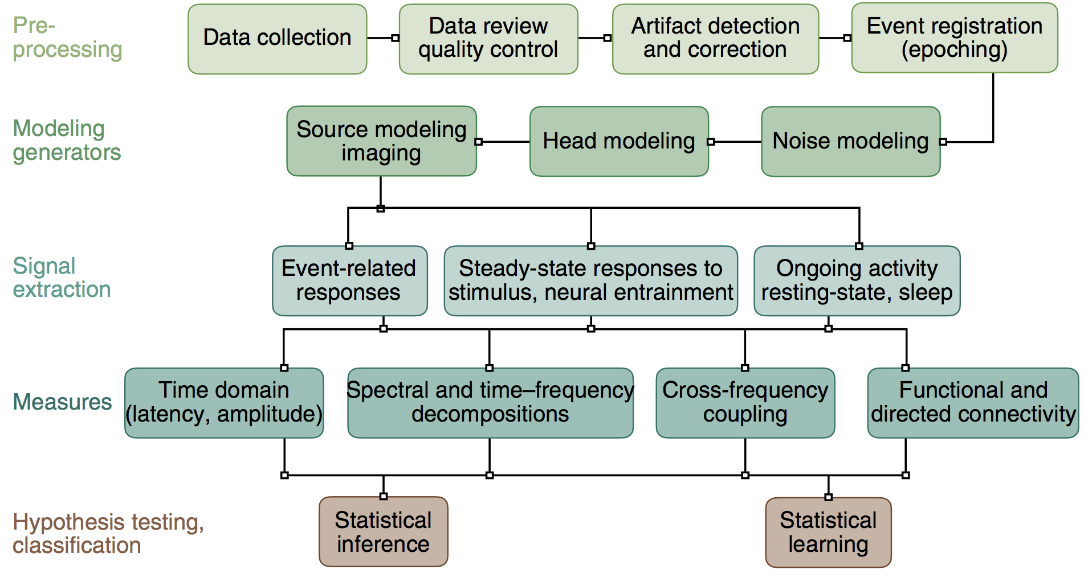
MEG analysis steps
Baillet et. al. 2017
Notes:
For MEG, we need to go through preprocessing, modeling, removing signal, measurmement correction, and statistical testings.
For most of the times, we follow similar procedures for EEG as well.
--------------------------------------------------------------------------------------------------------------------------------------------------------------------------------------------------------------------------------------------------------------------
(1) The preprocessing steps are crucial to assure that data quality is optimal at the time of collection and before engaging sophisticated signal extraction procedures. Data segments contaminated by artifacts need to be identified and rejected or attenuated.
(2) The modeling stage for MEG imaging requires that a few important options for parameters selection be considered carefully (for example, template versus individual head shape, noise definition, image reconstruction parameters).
(3) Signal extraction usually depends on the design of the experiment and is very versatile in MEG.
(4) The set of possible measures is immense because of the multidimensional components of the data (space, time, frequency).
(5) The final statistical steps can either include inference and hypothesis testing, or statistical learning techniques for signal classification, and other derivatives.
<Ref>
https://www.ucalgary.ca/i3t/files/i3t/baillet_2017.pdf

Slide 9
Analysis on longitudinal study of the “short-term” effects of brain stimulation with steady state visual stimulation on working memory performances in healthy volunteers
New experiment on “long term” effects of brain stimulation with Transcranial Magnetic Stimulation (TMS) on working memory performances in healthy volunteers
Developing automatic work-flow pipeline for data analysis
Notes:
So, the first work is short term effects of brain stimulation with visual on working memory!

Slide 10
Introduction
Neural oscillations can predict or correlate with participants’ performance
The causal relationship brain oscillations and behavior
needs to be clarified
Directly modulate brain oscillations during task performance and observe the consequences on behavior
Notes:
The previous papers only described level of correlation approaches, and our study explained the causal interactions.

Slide 11
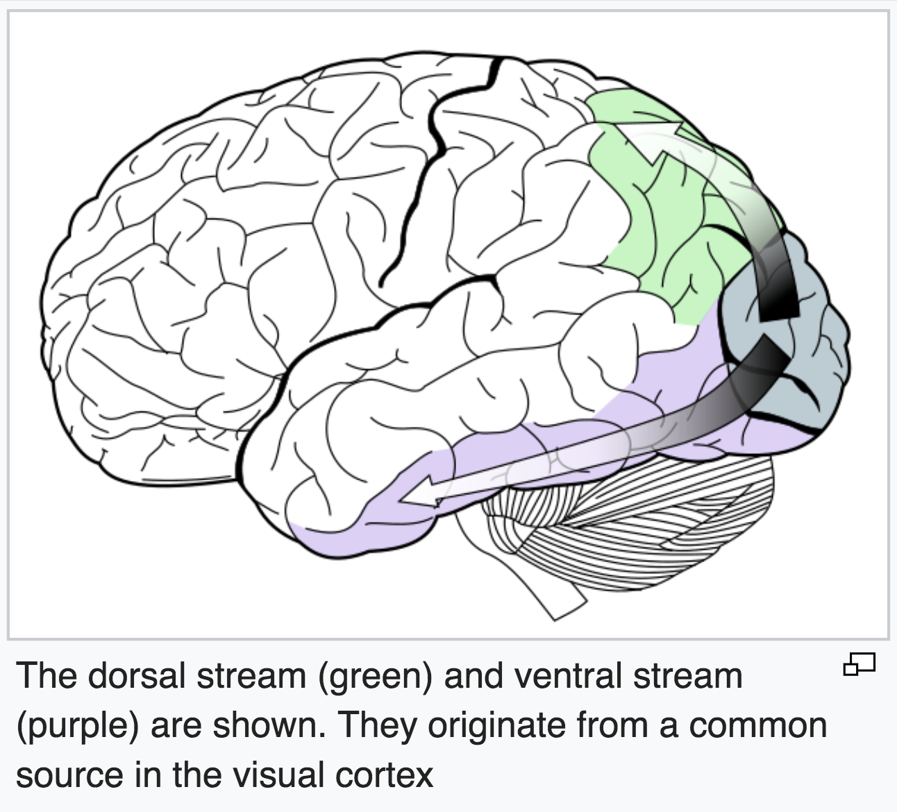
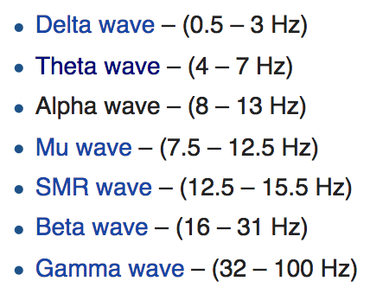
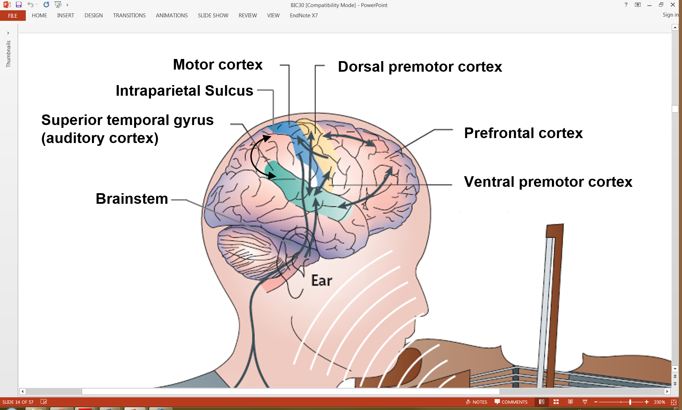
Selective entrainment of 5Hz
Theta range oscillations in the Dorsal Stream
<Side Note>
-> Ventral Stream: involve with simple memory processing such as simple melodies comparison
-> Dorsal Stream: involve with high-level processing such as memory manipulation
Notes:
with a special focus in the role of theta oscillations (5Hz) in a particular brain network = the dorsal stream , that involves parietal and frontal brain regions. Note that this pathways recruited for plenty of memory processes, such as visual and auditory memory
We are interested in theta range oscillations in the Dorsal stream.
<Ref>
https://www.zlab.mcgill.ca/publications/docs/Albouy_et_al_Neuron_2017.pdf
https://www.zlab.mcgill.ca/publications/docs/driving_working_mem_albouy.pdf

Slide 12
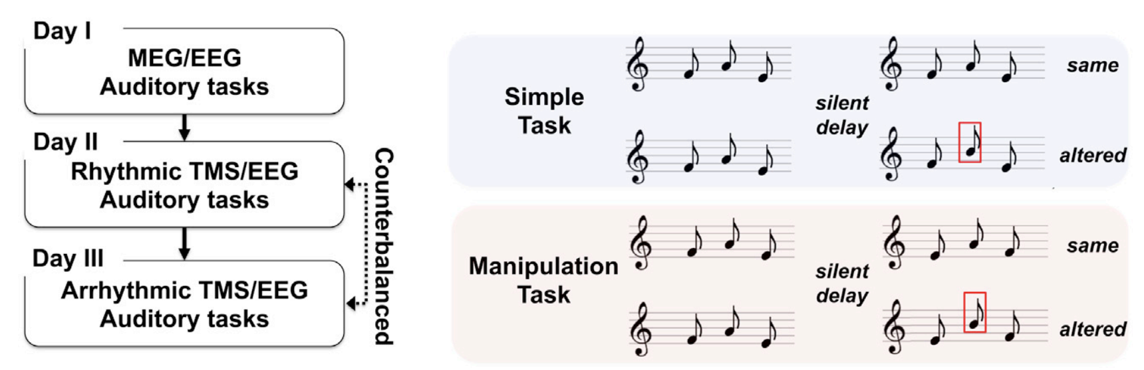
Auditory Tasks
Philippe
Notes:
We are measuring performance on these two tasks with stimulations:
Simple: just changed one in the middle.
Manipulation: changed on in the middle + reverse order

Slide 13
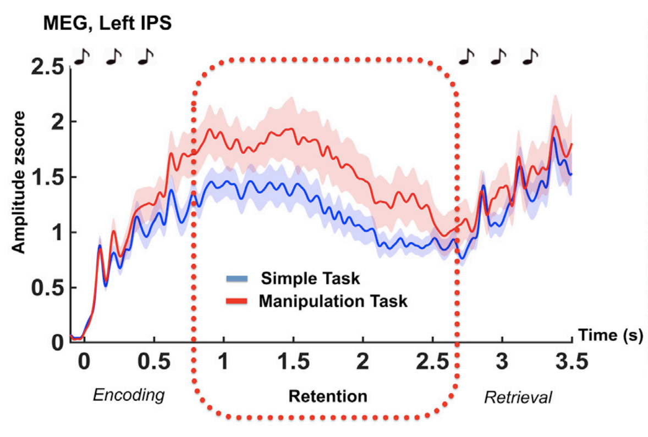
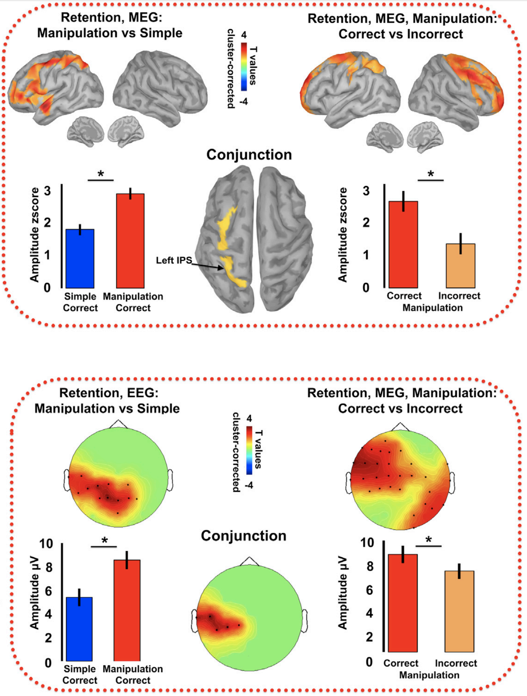
“Increased activity in the dorsal auditory stream supports correct manipulation of auditory information in memory”
Philippe
Notes:
Working memory is composed of three distinct stages: encoding (when information is registered), maintenance/retention (information kept in memory for few seconds or minutes), and retrieval (comparison between a memory trace and an ongoing stimulus)
Our model of interest is working memory, a cognitive ability that allow the short term retention and manupulation of information (audio, visual, tactile, olfactory).
With conjunction analysis, we decide left intraparietal sulcus as our region of interest.
In left intraparietal sulcus, manipulation task has relatively higher compared to simple task, in retention.
And, we get the conclusion of “Increased activity in the dorsal auditory stream supports correct manipulation of auditory information in memory”
--------------------------------------------------------------------------------------------------------------------------------------------------------------------------------------------------------------------------------------------------------------------
How to pick ”Region of Interest” (ROI):
Conjunction analysis between 1. manipulation v.s. simple (in correct trials) and 2. correct v.s. incorrect (in manipulation task)
→ Left pictures show some effects on left intraparietal sulcus and dorsal premotor cortex (using T statistics)
* Conjunction analysis: Find the intersection of both comparisons (man v.s simple and correct v.s Incorrect) for the purpose of reducing data dimensions
* For both MEG and EEG, many trials from each subject was averaged out for the purpose of reducing data dimensions

Slide 14
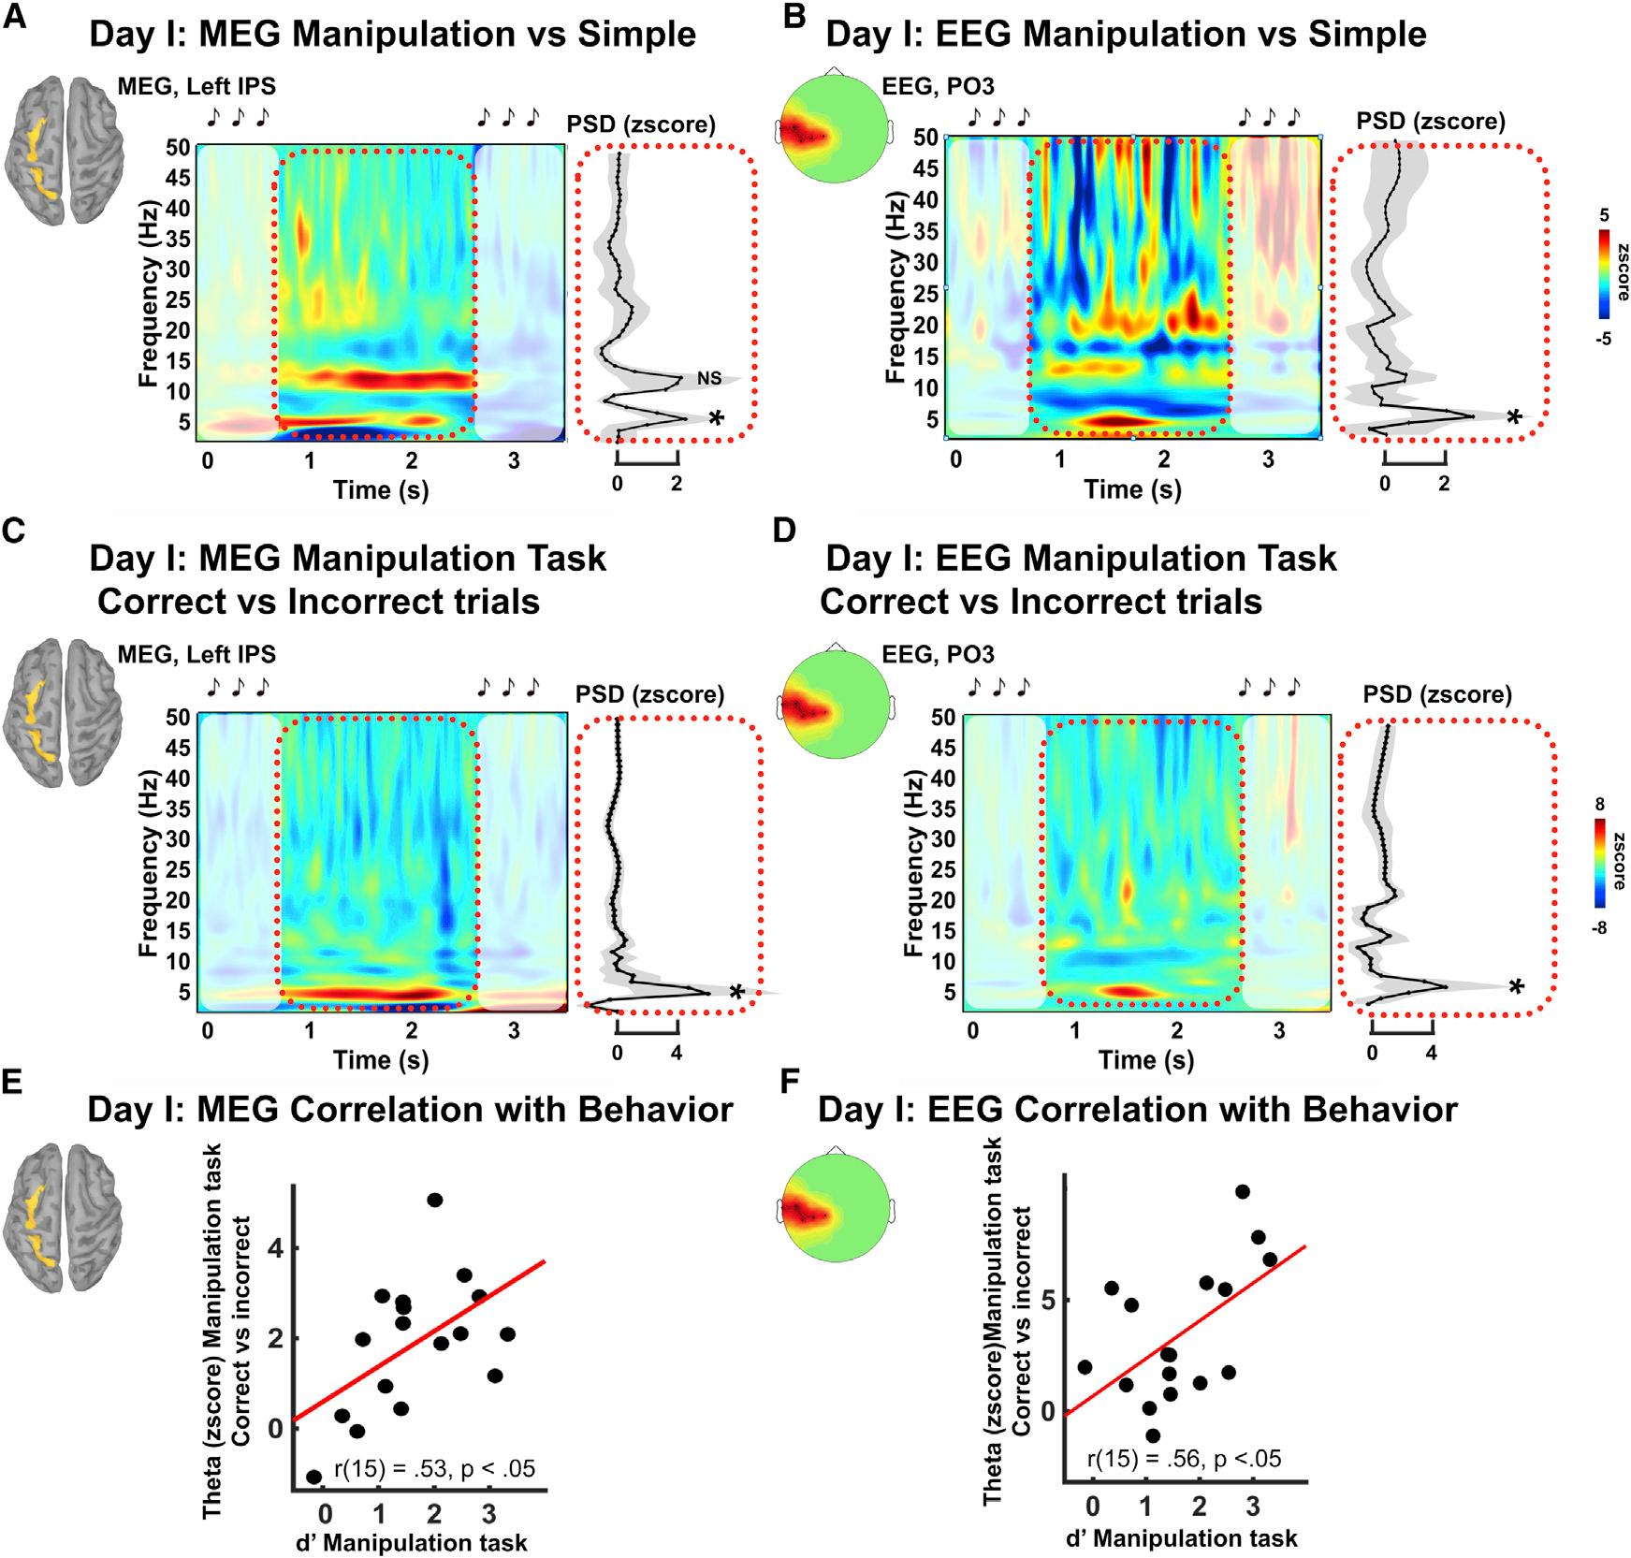
Theta activity in the dorsal pathway predicts participants’ performances
Manipulation vs Simple
Correct vs Incorrect trials
Manipulations Task
Theta power in the dorsal pathway during the retention period predicts participants manipulation abilities
Philippe
Notes:
So, now, we know that theta power in dorsal stream during retention predicts manipulation abilities.

Slide 15
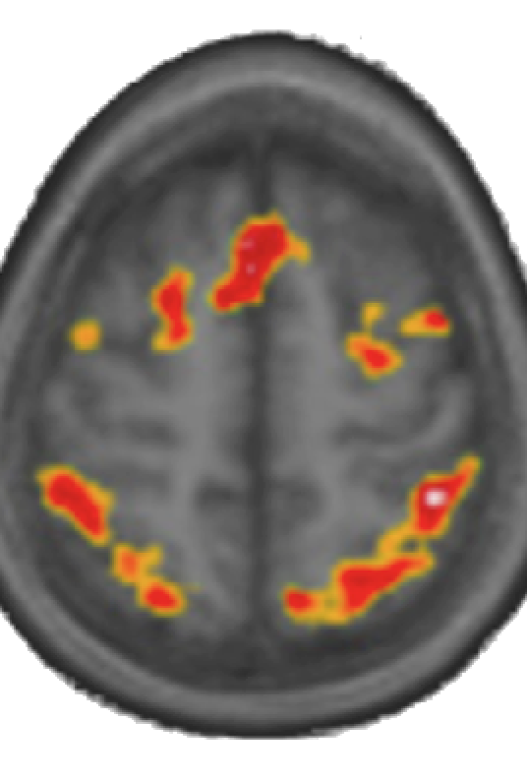
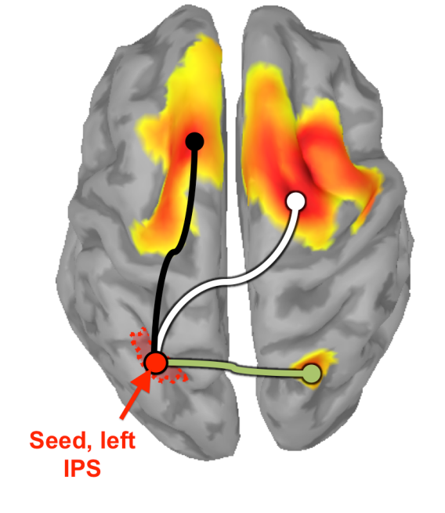
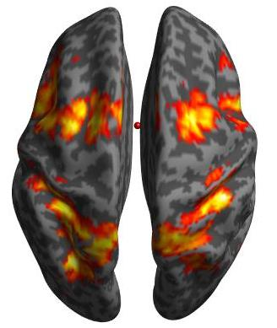
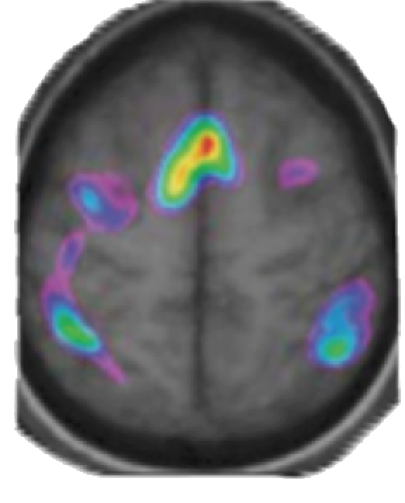
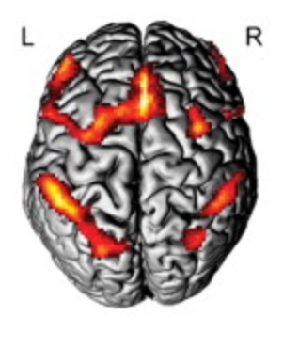
Manipulation of Melodies in Memory
Zatorre et al., 2010
Foster et al., 2013
Albouy et al., 2017
Malinovitch et al, in preparation
Quantitative calculation, Visual mental rotation …
Zago et al., 2008
Notes:
Until now, we only used the auditorial stimulations, but from the other papers, this dorsal stream is stimulated with visual rotation. So, we can boost networks with visuals.
Auditory memory recruits the dorsal pathway. However this pathway (stream) is also recruited during other cognitive processes, such as calculation or visual mental rotation.
The idea is so to use visual stimulation to boost activity in this brain network during auditory task performance.

Slide 16
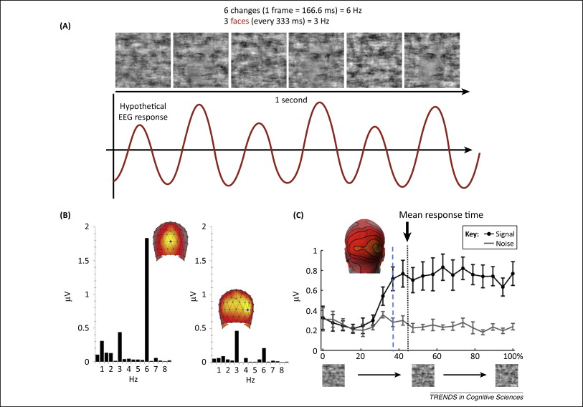
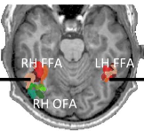
Fast periodic visual stimulation
(Steady state responses)
See Rossion (2014)

Slide 17
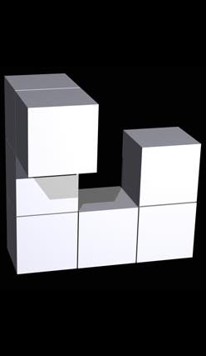
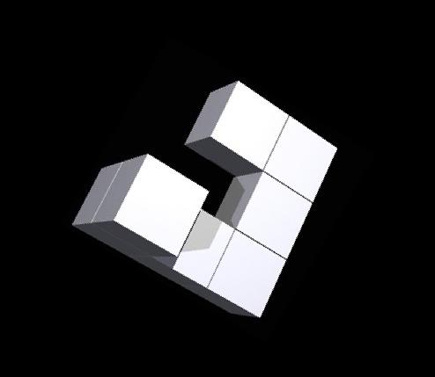
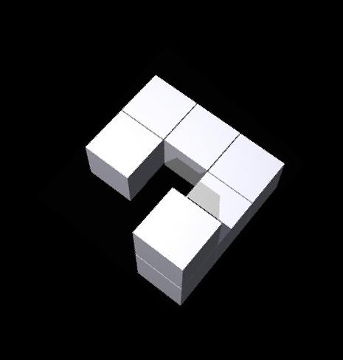

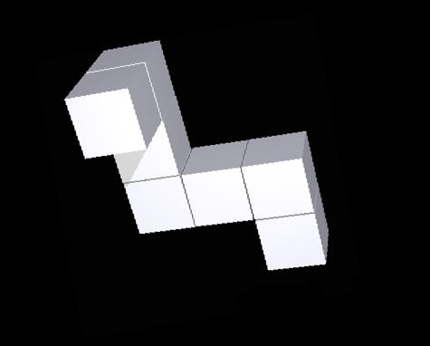
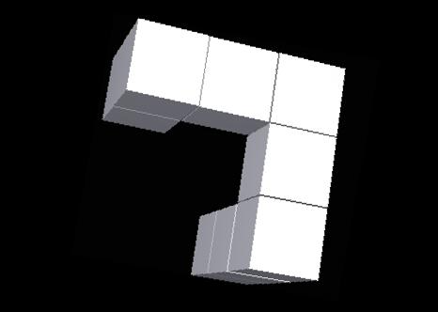
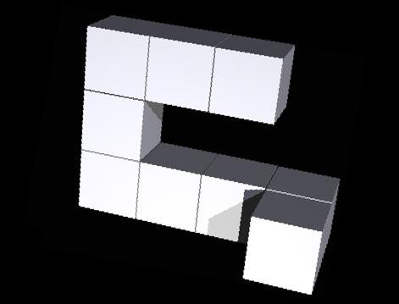
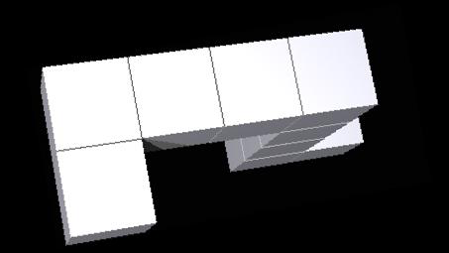
Visual Stimulation
Steady state stimulation: 5Hz visual stimulation
Rotating Shepard’s form
Random Shepard’s forms
Philippe
Notes:
We use the two types of 5 Hz visual stimulations: rotating and random.
Rotating should boost activity in the dorsal pathway, while random should entrain activity only in visual areas.

Slide 18
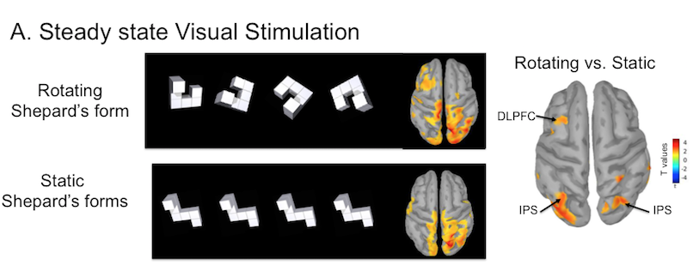
SSVS
Passive observation of rotation (steady state)
Random
Random
Philippe
Notes:
And, We found that rhythmic visual stimulation (passive observation) of rotating objects entrains brain activity in dorsal prefrontal cortex and intraparietal sulcus at the freuqency of stimulation.
DLPFC: dorsal left prefrontal cortex

Slide 19








Without visual
stimuli
…
…
Baseline visual stimuli
…
…
Delay visual
stimuli
…
…
Zaida Martinez Moreno
Notes:
This is how visual stimulation was performed.

Slide 20
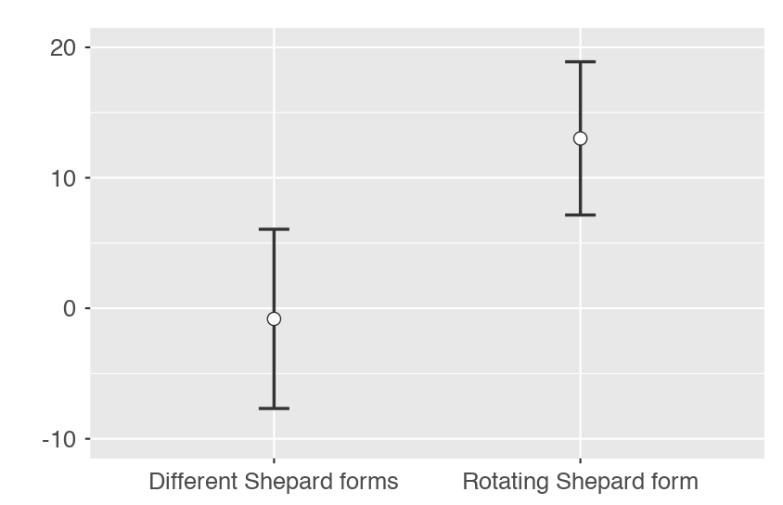
11 non-musicians,
Reversed task
4sec visual stimulation (baseline only)
Hit –FA
Stimulation - No Stimulation
Random
Around 13% of behavioral benefit: EEG data → try to link behavioral benefits to oscillatory entrainment
Notes:
Now it shows rotatting visual stimulations can show 13% of behavioral benefits compared to the one without stimulation.

Slide 21
Temporary Conclusion
Rotating visual stimulation enhances brain oscillations to boost participants’ manipulation abilities in auditory memory.
* Other types of stimulations such as gamma can improve working memory, we only care about theta stimulations, theta oscillations are easier to control and we could well work on it…
Notes:
I said ”temporary” because our group is extending the study, and currently performing extra analysis on it.
Rhythmic transcranial magnetic stimulation (TMS) and rotating visual stimulation causally enhances brain oscillations to boost participants’ manipulation abilities in auditory memory.
<Ref>
https://www.zlab.mcgill.ca/publications/docs/driving_working_mem_albouy.pdf

Slide 22
<Exact time frame> (unit: seconds)
Baseline without long: -2 ~ 0 of visual stimulation, 0 ~ 0.75 of first melody, 0.75 ~ 2.75 of break, 2.75 ~ 3.5 of second melody
Baseline with long: -4 ~ 0 of visual stimulation, 0 ~ 0.75 of first melody, 0.75 ~ 2.75 of break, 2.75 ~ 3.5 of second melody
No baseline with visual stimulation: 0 ~ 0.75 of first melody, 0.75 ~ 2.75 of visual stimulation, 2.75 ~ 3.5 of second melody
No baseline without visual stimulation: 0 ~ 0.75 of first melody, 0.75 ~ 2.75 of break, 2.75 ~ 3.5 of second melody
Baseline with long: -4 ~ 0 of visual stimulation, 0 ~ 0.75 of first melody, 0.75 ~ 2.75 of break, 2.75 ~ 3.5 of second melody
Notes:
Again, this is the summary of it.

Slide 23
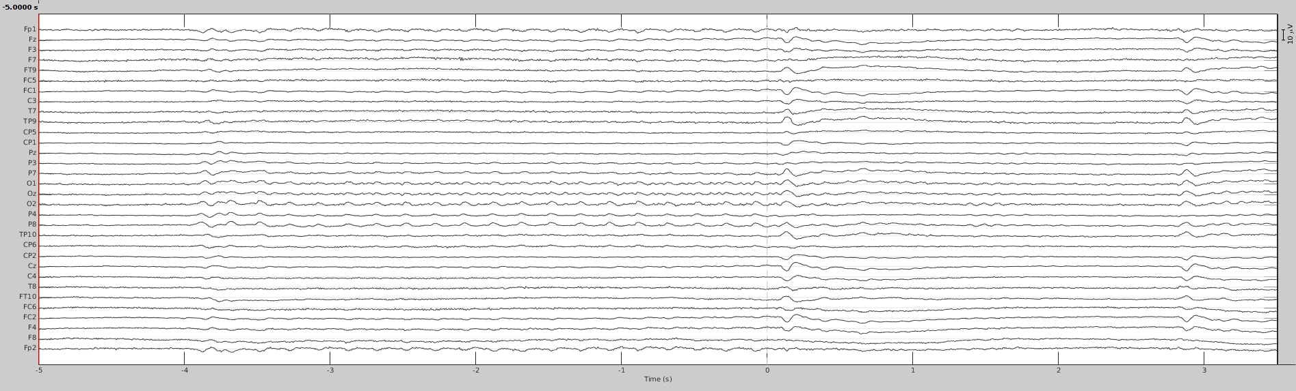
blsrr (*Both visual and auditory stimulations are responsive around 100ms after – information has to travel from sensory receptors such as eyes and ears to the cortex via subcortical nuclei)
Notes:
You can see that some signals -3.9s going upto 0s. 100ms to 750ms of the first melody. 750 ~ 2750 ms of break, and 2750 ~ 3500 ms of the second melody.
--------------------------------------------------------------------------------------------------------------------------------------------------------------------------------------------------------------------------------------------------------------------
Baseline with long: -4 ~ 0 of visual stimulation, 0 ~ 0.75 of first melody, 0.75 ~ 2.75 of break, 2.75 ~ 3.5 of second melody
blsrr = baseline long stimuli reversed rotation

Slide 24
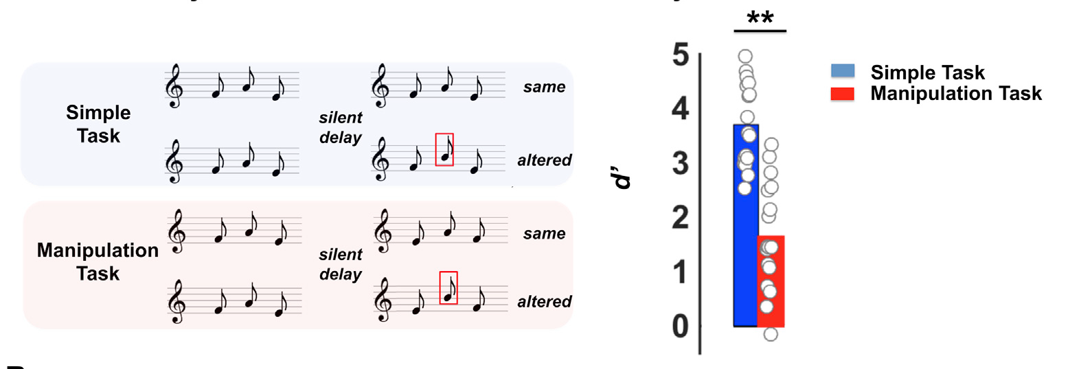
4 second stimulation
Zaida
Notes:
In the first condition participants do the task without visual stimulations.
In the second condition, 4 sec of 5Hz rotating visual stimulation before each trial
In the third condition, 4 sec of 5Hz random visual stimulation before each trial
We expect condition 2 to boost activity at 5Hz in the dorsal pathway, and thus boost behavioral performance.

Slide 25
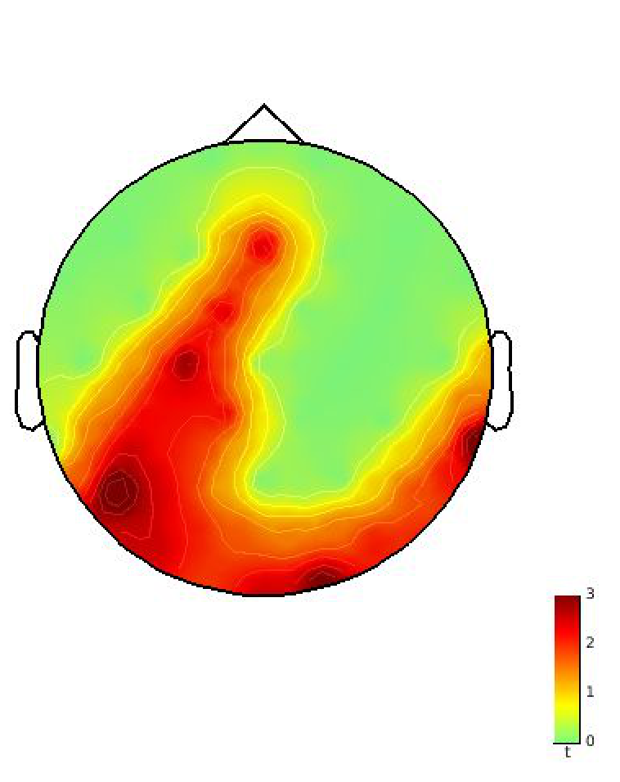
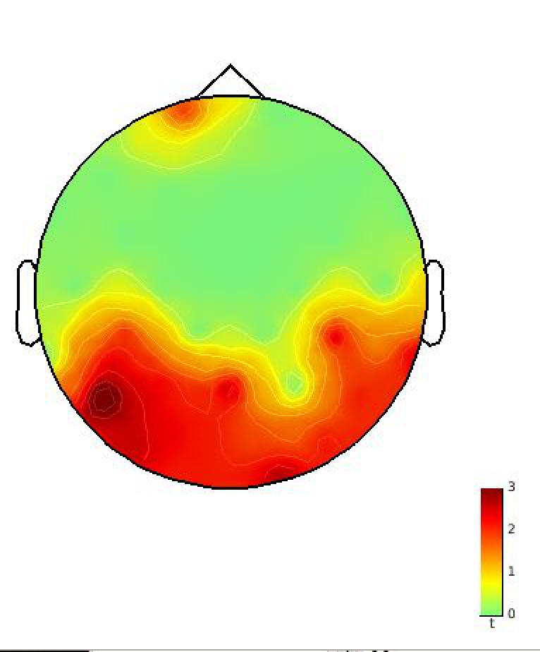
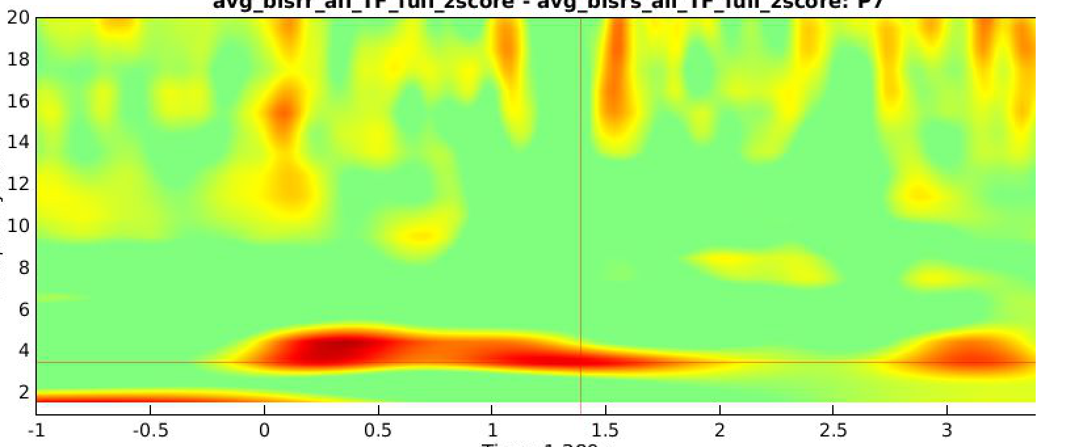
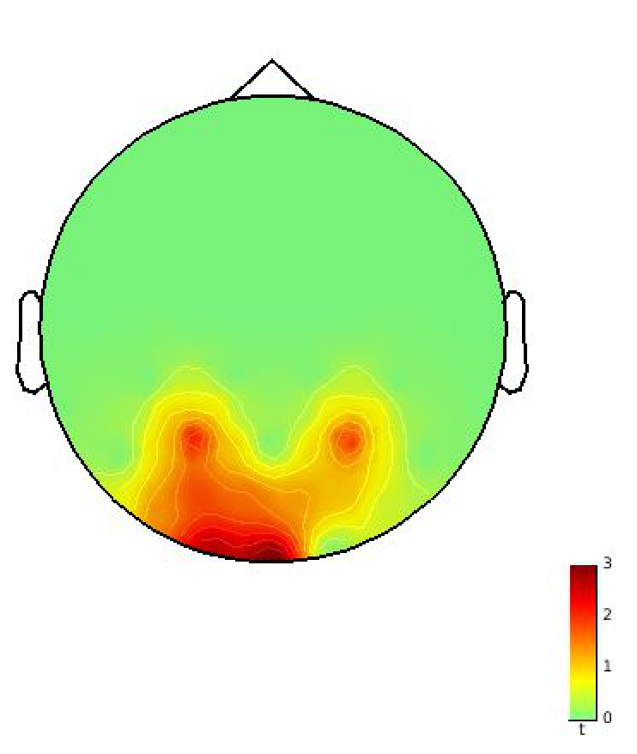
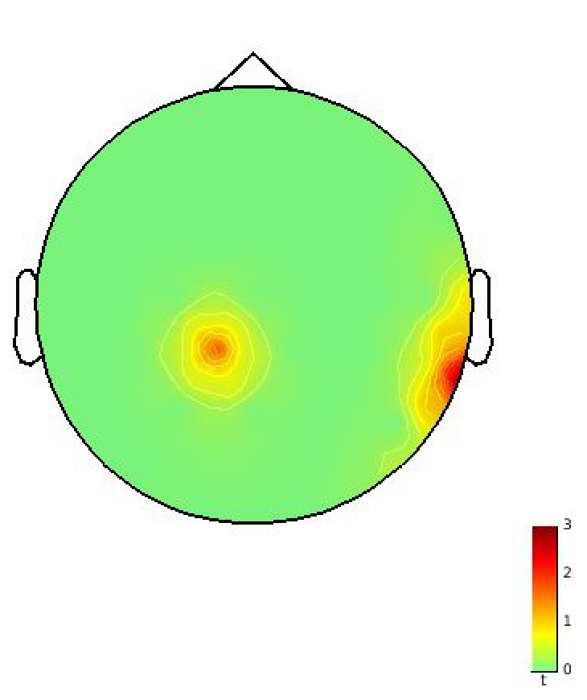
Rotate vs no stim
Random vs no stim
Rotate vs Random
4Hz
Frequency
Time
Notes:
So, we found that when it comes to rotation, it shows more dorsal strim entrainment, than static visual stimulation.
First we show that theta activity is boosted in the dorsal stream during task performance for rotating stimuli only.

Slide 26
Analysis on longitudinal study of the “short-term” effects of brain stimulation with steady state visual stimulation on working memory performances in healthy volunteers
New experiment on “long term” effects of brain stimulation with Transcranial Magnetic Stimulation (TMS) on working memory performances in healthy volunteers
Developing automatic work-flow pipeline for data analysis
Notes:
The second thing I did was I am actually playing with TMS, EEG, and MEG for checking the long term effects. (so, now it is 7 sessions, not 3 sessions)

Slide 27
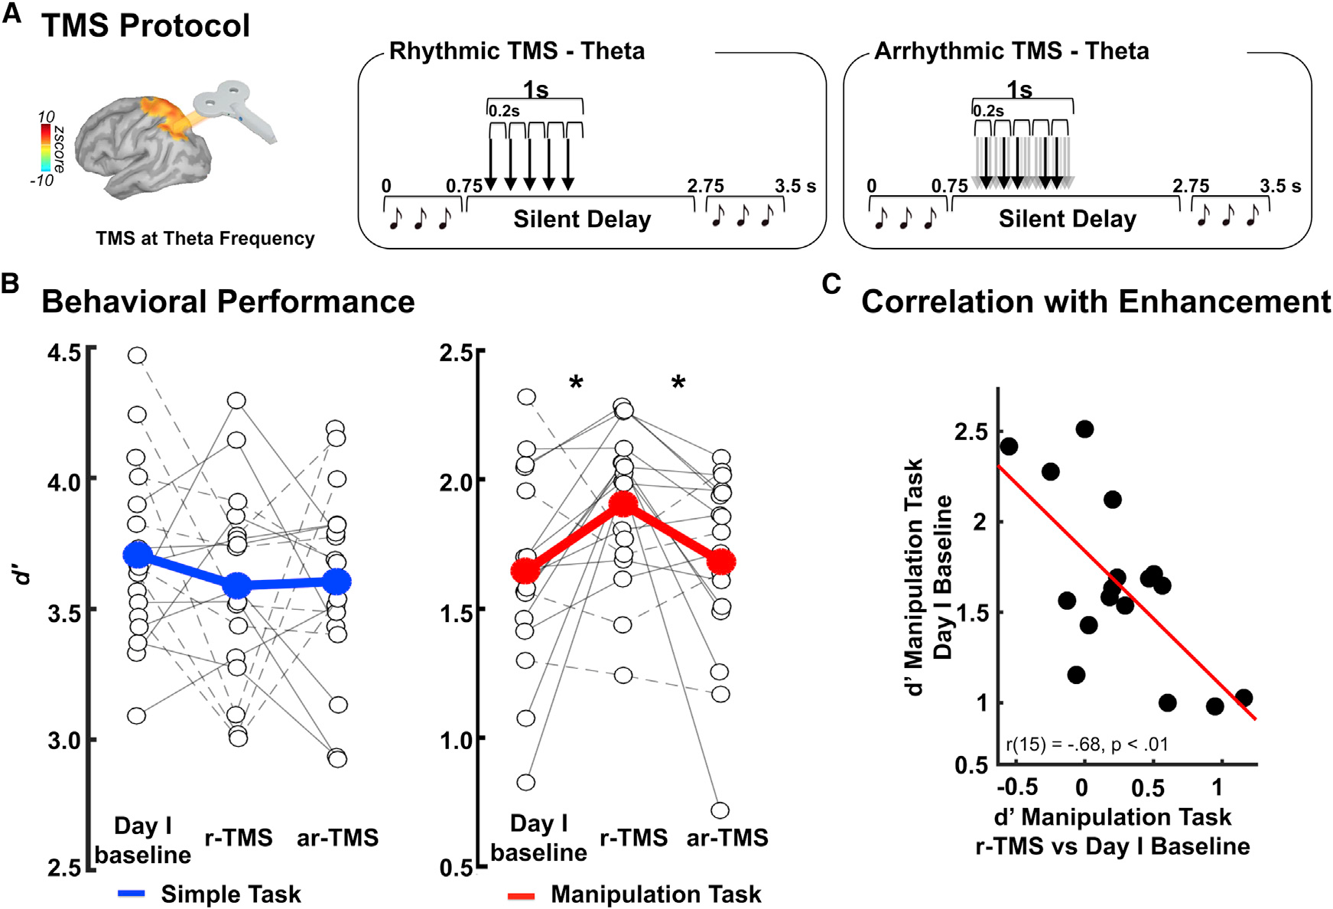

Selectively entraining the manipulation network
Performance d’
* Noninvasive brain stimulation techniques are great tools to investigate the causal relationship between brain and behavior (Albouy, Baillet, Zatorre, 2018)
Ø TMS
r-TMS
ar-TMS
Albouy, Weiss, Baillet, Zatorre 2017 Neuron
Notes:
As Sylvain talked on Tuesday Seminar, we use the delivery of 5Hz stimulation in the dorsal pathway with TMS boost working memory manipulation abilities

Slide 28
Our goal of doing new experiment is:
to identify if there is any long-term effect.
to boost manipulation and learning during task performance, by leading repeated behavioral sessions and repeated stimulations. (so basically, the only difference is that we make the subjects repeat more and making the tasks become more difficult)
Notes:
So doing another study in the lab is to identify if there is any long-term effect.
We boost manipulation and learning during task performance, by leading repeated behavioral sessions and repeated stimulations.
So, basically, the only difference is that we make the subjects repeat more and making the tasks become more difficult.

Slide 29
How is it actually different with the previous study?
In the previous experiment/paper, there was only 1 session of training in Day2. However, this time, we did 5 sessions of trainings to the 3 groups, and we trained them and see the long-term effects from there. (20 participants per group with various musical experience)
* Sham stimulation: generic term to indicate an inactive form of stimulation such as very brief or weak one that is used in research to control for the placebo effect; meaning that the subjects believe he/she is being stimulated normally, but there should not be any real effects. (https://www.neuroelectrics.com/wiki/index.php?title=About_tCS)

Slide 30
Hypothesis and Process
First two groups are trained (first group is trained with rhythmic, second is with rhythmic Sham stimulation), and the third group is not trained at all. (rhythmic stimulation) – stimulation is TMS
Our initial hypothesis is to expect to see the result of first group is doing the best, second is getting better but yet less improvement showing than the first group, and the third group would show not significant improvement as time goes
Step1: MEG/EEG pre-training 1 day
Step2: Training sessions (TMS/EEG) 5days
Step3: MEG/EEG post-training 1 day

Slide 31
Analysis on longitudinal study of the “short-term” effects of brain stimulation with steady state visual stimulation on working memory performances in healthy volunteers
New experiment on “long term” effects of brain stimulation with Transcranial Magnetic Stimulation (TMS) on working memory performances in healthy volunteers
Developing automatic work-flow pipeline for data analysis
Notes:
My third work is improving data pipeline.

Slide 32
Data pipeline flow fix
1. Visual inspection
2. Identify bad channels; reject or interpolate
3. Line noise removal
4. High pass or band pass filter
5. Cardiac, blink, saccades artifact removal
6. Muscle artifact removal
7. Motion artifact removal
8. Environmental noise removal
9. Identify bad segments; reject or interpolate
10. Head motion correction
MEG is quite new technology compared to EEG, and many of the analyzing techniques/pipelines are still not fully well-developed.
The software, “Brainstorm” definitely does a lot of good analysis on MEG data, but still give hard time for new users.
Preprocessing and modeling generating are really important steps.
We want to make the pipeline that can do all those 10 steps automatically when we input MEG data. It will help not only new users but the experienced to do work efficiently.
I, particularly spend most time on step 2: Identify bad channels.
Marc
Notes:
Since MEG is quite new technology compared to EEG, there are not enough automatic algorithms constructed yet.

Slide 33
Types of pre-processing
Power line contaminations (60, 120, 180 Hz) - notch filter
Extreme frequency – band-pass filter
Eye blink contaminations
Set Epoch Time (in ms)
Categorize based on conditions
(auditory: simple and manipulation
visualization: simple and static)
Bad channels
Saccades
Topography analysis
Time-frequency map analysis
Standardize and average and baseline normalization
Notes:
Again, the one of the most important process is preprocessing of the datas.

Slide 34
Identify Bad Channels
Read different journals talking about some pipelines: PREP, HAPPE, MNE, and FASTER.
All of those pipelines from different journals use different algorithms and logics to identify bad channels.
I and Marc analyzed the math, and tried to find the combinations of algorithms from these four journals, to construct the BEST pipelines
*Side note: There are not many bad channels to test pipelines…

Slide 35

Our Final Criteria
Prep1
Deviation criteria - Extreme amplitudes (noisy channels – variance):
Not identify channels that capture eye blinks and most muscle activity as noisy.
Works well for detecting of unusual high amplitudes but not work well for extremely low, non zero amplitudes.
One way to look at larger amplitude.
1. "0.7 IQR" (+/-0.7 z values for normal curve) of amplitudes
2. Robust z relative to channels > 5
Prep2
Correlation criteria Lack of correlation with any other channel
Low frequency portion of EEG is somewhat but not too much correlated among channels
1. 50 Hz low pass, 98th percentile absolute correlation with other channels, per 1 s time windows.
2. Bad if ”98th channel” < 0.4 for at least 1% of windows.
275, in order
Prep5
Significant periods of constant or very small values
Small/constant values for some time window (0.5 ~ 1sec) are not really possible
98th
HAPPE
Normed joint probability of the average log power from 1 to 125 Hz across channels. Z > 3 are removed. Performed twice.
Notes:
If any of the conditions fail, then the channels would be removed.
By the way, the second condition of Prep pipeline usually catches most of the bad channels.

Slide 36
What I like to further do in the lab

Slide 37
First

Slide 38
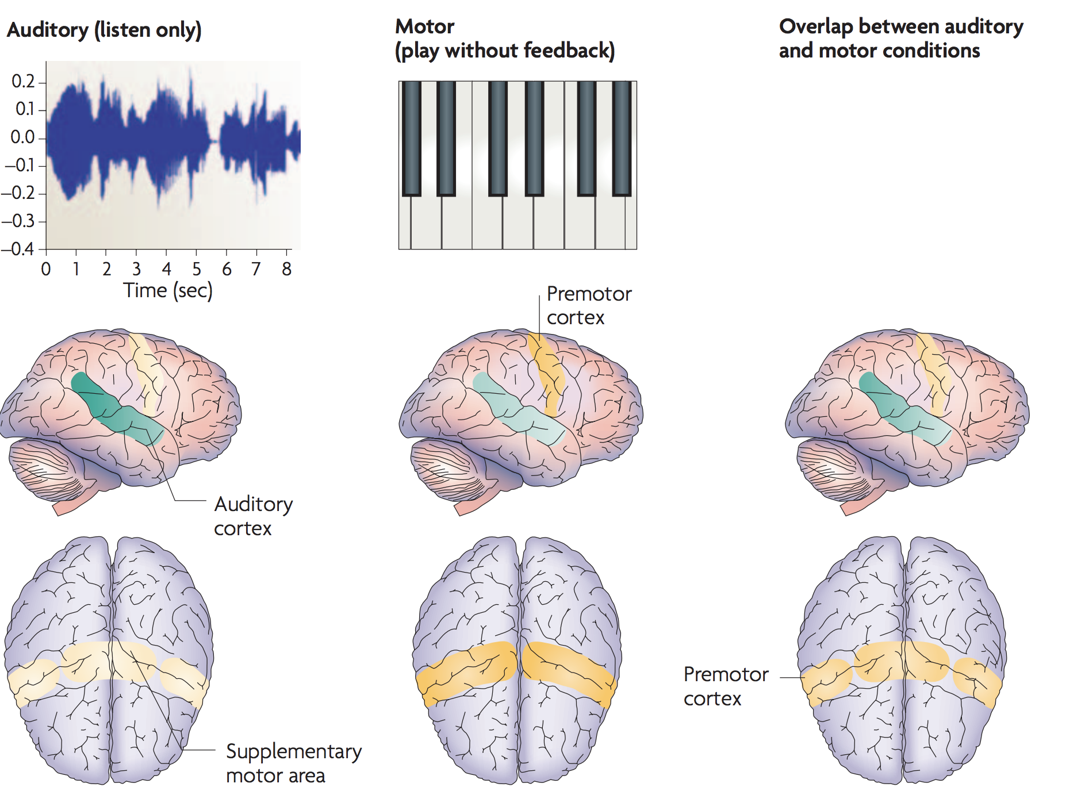
“When the brain plays music: auditory–motor interactions in music perception and production” (Zatorre. et.al. 2017) mentions that
“dorsal premotor cortex (dPMC) and ventral premotor cortex (vPMC) are functionally organized such that it can compute a variety of sensory-motor transformations that are relevant for music.”
-> So, for example, when a person is listening to the music, he/she matches properties of the visual object with an appropriate motor gesture
The pictures (left) showed us that there are definitely significant overlaps between auditory and premotor regions.
It shows that “auditory” and “motor” systems are interacting in both music perception and production.
Notes:
<Ref>
https://www.zlab.mcgill.ca/publications/docs/Zatorre_et_all_2007.pdf

Slide 39
Based on what it said, for the next experiment, why don’t we also check motor working memory as well? (not just auditory)
Selective entrainment of theta oscillations in the Dorsal Stream causally enhances auditory working memory (short-term memory) performance and maybe
also motor memory…???
Notes:
If I have a chance, I would also want to see motor memory could be also improved with the same stimulations on we did.
--------------------------------------------------------------------------------------------------------------------------------------------------------------------------------------------------------------------------------------------------------------------
Later when I talked with Philippe and prof. Baillet, I found out they have been working on similar project (http://www.pnas.org/content/114/42/E8913; title: Motor origin of temporal predictions in auditory attention)

Slide 40
Second

Slide 41
continuous movie…???
Instead of flicking Visual stimulation can be
Without visual
stimuli
…
…
Baseline visual stimuli
…
…
Delay visual
stimuli
…
…
Notes:
Also, I want to see how could continuous movie (not flicking movie) change the study.

Slide 42

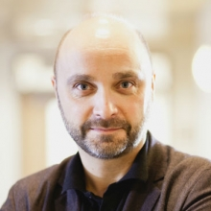


Special Thanks to
PhD. Philippe Albouy
Dr. Sylvain Baillet
Dr. Robert Zatorre
Marc Lalancette
Notes:
Last but not least, I want to say special thank you for Philippe, Sylvain, Robert, and Marc to guide me through all the times and being with me whenever I need helps.

